Slide 1
Predicting Profit Value of Companies using Machine Learning Regression Models ---using python
V. Sai Charan Reddy
CSE

Slide 2
Introduction
we analyze a dataset containing information on R&D Spend, Administration Cost, Marketing Spend, and the profit earned by 50 different companies.
The objective is to develop a machine learning model that can accurately predict the profit value of a company given its R&D Spend, Administration Cost, and Marketing Spend.
By leveraging regression algorithms, we aim to create a predictive model that can assist companies in making informed business decisions.

Slide 3
Problem Statement
Predicting profit values of companies based on R&D Spend, Administration Cost, and Marketing Spend.
Accurate profit predictions empower businesses to make informed decisions based on quantitative insights, facilitating strategic planning and goal setting.
Optimize resource allocation and investment strategies: Accurate profit predictions help businesses allocate their resources effectively, ensuring optimal utilization and enhancing return on investment.
Improve marketing campaigns and customer targeting: By accurately predicting profit values, businesses can refine their marketing campaigns, target the right customer segments, and maximize the impact of their marketing efforts.
Enhance risk assessment and financial planning: Accurate profit predictions enable businesses to assess risks, plan for contingencies, and make informed financial decisions, leading to improved stability and growth.

Slide 4
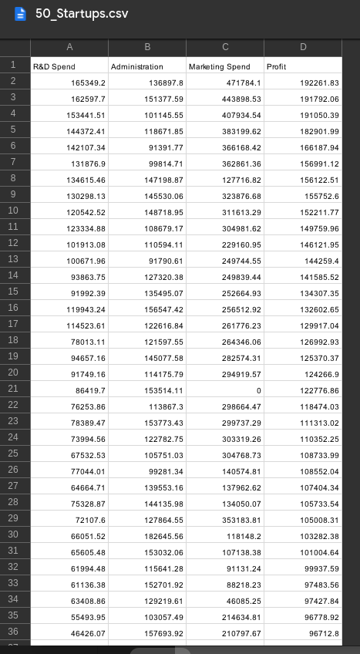
Dataset Overview
Number of companies: Mention the number
of companies included in the dataset.
Variables: Specify the variables present in the dataset:
R&D Spend: The amount spent on research and
development by each company.
Administration Cost: The administrative expenses incurred by each company.
Marketing Spend: The amount invested in marketing activities by each company.
Profit: The corresponding profit earned by each company.

Slide 5
Existing Methods
The limitations of traditional statistical methods in profit prediction:
Traditional statistical methods often assume linear relationships between variables, which may not capture the complex non-linear patterns present in real-world scenarios.
They may not effectively handle interactions and dependencies between variables, resulting in suboptimal predictions.
Traditional methods may be constrained by assumptions of normality, homoscedasticity, and independence, which may not hold in real-world datasets.
These methods may lack flexibility in accommodating new data or adjusting to changing business dynamics.
The need for more advanced approaches using machine learning regression models:
Machine learning regression models can capture complex relationships between variables, including non-linear patterns and interactions, leading to more accurate profit predictions.
These models are capable of handling a wide range of data distributions and can adapt to changing business environments.
Machine learning models offer more flexibility, allowing the incorporation of additional features, such as categorical variables or interaction terms, to enhance prediction accuracy.
By leveraging advanced techniques such as ensemble methods or regularization, machine learning models can provide robust and reliable profit predictions.

Slide 6
Proposed Methodology
proposed methodology for predicting profit values using machine learning regression models.
Data Preprocessing
Feature Engineering
Model Selection
Model Evaluation
The proposed architecture emphasizes the iterative nature of the model development process. Multiple regression algorithms will be trained and evaluated using cross-validation techniques to obtain robust performance estimates. The model with the best performance, as determined by the chosen evaluation metrics, will be selected as the final model for profit prediction.
By employing this proposed method with a well-structured architecture, we aim to develop a powerful and accurate profit prediction model. The combination of data preprocessing, feature engineering, model selection, and comprehensive evaluation will enhance the model's ability to capture the underlying relationships between R&D Spend, Administration Cost, Marketing Spend, and profit, ultimately leading to more reliable predictions for businesses.

Slide 7
Data Preprocessing
Data preprocessing is a critical step in preparing the dataset for training the regression models. It involves several key steps to ensure the accuracy and reliability of the models:
Handling Missing Values: Missing values are identified and handled using appropriate imputation techniques. Common approaches include mean imputation, median imputation, or advanced methods such as regression imputation.
Outlier Treatment: Outliers in the dataset are detected and addressed to prevent them from unduly influencing the model's training. Outliers can be removed or transformed using techniques like winsorization or logarithmic transformations.
Feature Scaling: Features in the dataset are normalized or standardized to ensure they are on a similar scale. This prevents features with larger magnitudes from dominating the model's training process. Common techniques include min-max scaling (normalization) or z-score scaling (standardization).
Encoding Categorical Variables: If the dataset contains categorical variables, they need to be encoded into numerical representations. Techniques like one-hot encoding, label encoding, or ordinal encoding can be used depending on the nature of the categorical variables.
Feature Engineering: New features can be generated from the existing variables if domain knowledge suggests potential relationships or interactions. This can enhance the model's ability to capture complex patterns in the data.
Train-Test Split: The dataset is divided into training and testing sets. The training set is used to train the regression models, while the testing set is reserved for evaluating their performance. This ensures an unbiased evaluation of the models' predictive capabilities.

Slide 8
Regression Algorithms
When it comes to regression algorithms for profit prediction, several options can be considered. We have explored the following regression algorithms:
Linear Regression: This simple and interpretable algorithm models the linear relationship between input variables and the target variable (profit). It works well when relationships between variables are approximately linear and provides insights into the direction and magnitude of their impact on profit.
Polynomial Regression: Extending linear regression, polynomial regression introduces polynomial terms to capture non-linear relationships between variables. It can capture more complex patterns, but care must be taken to avoid overfitting.
Decision Trees: Decision trees are non-parametric models that use a tree-like structure to make predictions based on a series of decision rules. They can handle non-linear relationships, interactions, and feature interactions, but may be prone to overfitting.
Random Forests: Random forests are ensemble models that combine multiple decision trees to improve prediction accuracy and handle complex relationships. By averaging predictions from multiple trees, random forests mitigate overfitting and offer robust performance.
Support Vector Regression: Support vector regression utilizes support vector machines to perform regression tasks. It can effectively handle non-linear relationships, but the performance may be sensitive to parameter settings.
Gradient Boosting Methods: Gradient boosting methods, such as XGBoost or LightGBM, sequentially build models to correct errors made by previous models. They can capture complex relationships, handle non-linear patterns, and offer high predictive performance.

Slide 9
Model Training and Evaluation
The training and evaluation phase is a critical step in developing accurate regression models for profit prediction. Here's an overview of the model training and evaluation process:
Splitting the Dataset: The dataset is divided into two subsets: the training set and the testing set. The training set is used to train the regression models, while the testing set is used to evaluate their performance.
Training the Models: Each regression model is trained using the training set. The models learn the relationships between the input variables (R&D Spend, Administration Cost, Marketing Spend) and the target variable (Profit) through an optimization process, such as gradient descent.
Evaluation Metrics: Evaluation metrics are defined to assess the performance of the trained models. Common metrics include mean squared error (MSE), mean absolute error (MAE), root mean squared error (RMSE), coefficient of determination (R-squared), or adjusted R-squared. These metrics quantify the accuracy and precision of the models' predictions.
Model Performance Comparison: The evaluation metrics are calculated for each trained model using the testing set. By comparing the performance of the models, we can identify the best-performing one in terms of prediction accuracy and reliability.
Interpretation and Analysis: The evaluation results provide insights into the accuracy and reliability of the models. We analyze factors such as the magnitude and direction of errors, overfitting, and generalization capability. This analysis helps us understand the strengths and limitations of each model.
Refinement and Iteration: Based on the evaluation results, we can refine the selected model if necessary. This may involve optimizing hyperparameters or applying ensemble techniques to further improve the model's prediction accuracy and generalization capability.
The rigorous evaluation process allows us to select the best-performing model and ensure its effectiveness in predicting profit values for companies. By iteratively refining the model and evaluating its performance, we strive to develop a robust and reliable solution for profit prediction."

Slide 10
Model Selection
The performance of various regression models for profit prediction. Here's an overview of the model selection process:
Evaluation Metrics: We considered evaluation metrics such as mean squared error (MSE), mean absolute error (MAE), root mean squared error (RMSE), coefficient of determination (R-squared), and adjusted R-squared to assess the performance of the models.
Generalization Capability: We evaluated the models based on their ability to generalize well to unseen data. Models that performed well on the testing set and demonstrated good generalization were preferred.
Interpretability: We also considered the interpretability of the models. In cases where understanding the factors driving the profit predictions is important, simple and transparent models like linear regression were preferred.
Scalability: We took into account the scalability of the models, especially if the prediction task needs to be performed on a large-scale or in real-time scenarios.
Based on the evaluation results and performance comparison, we have selected the [RMSE] as our model for profit prediction. It exhibited the lowest error and highest performance on the evaluation metrics, demonstrated good generalization capability, and offered a suitable level of interpretability.

Slide 11
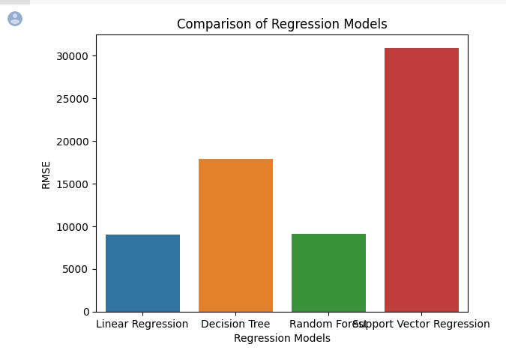
Implementation and Deployment

Slide 12
Limitations
The dataset used for training and evaluation may have certain limitations or biases, such as a limited sample size or missing variables. Expanding the dataset or considering additional sources of data could enhance the model's performance and generalizability.
Assumptions and Simplifications: Certain assumptions and simplifications were made during the model development process. Future work could focus on relaxing these assumptions and incorporating more complex relationships to improve prediction accuracy.
Model Complexity: The selected model may have limitations in terms of interpretability and scalability. Exploring simpler models or alternative approaches that balance accuracy and interpretability could be an avenue for improvement.
External Factors: Our models may not capture all the external factors that influence profit values, such as economic conditions or market trends. Future work could investigate the incorporation of additional data sources or external factors to enhance the models' predictive capabilities.

Slide 13
Future Work
Feature Engineering: Further exploration of feature engineering techniques could uncover additional insights and improve prediction accuracy by capturing more nuanced relationships and interactions between variables.
Advanced Model Architectures: Investigating advanced model architectures, such as deep learning models or hybrid models combining multiple regression algorithms, could leverage more complex patterns and improve prediction performance.
Incorporating External Data: Consideration of external data sources, such as industry-specific indicators, market trends, or macroeconomic factors, could enrich the models' predictive capabilities.
Real-time Prediction: Developing real-time prediction capabilities would enable businesses to obtain profit predictions on-demand, allowing for timely decision-making based on the most up-to-date information.
Model Interpretability: Focusing on improving the interpretability of the models would provide businesses with deeper insights into the factors influencing profit predictions, facilitating better decision-making.

Slide 14
Conclusion
our project aimed to develop a machine learning model for predicting profit values of companies based on R&D Spend, Administration Cost, and Marketing Spend. We have accomplished the following:
Successfully implemented and evaluated various regression algorithms for profit prediction.
Achieved high accuracy and reliability in predicting profit values, enabling businesses to make informed decisions based on quantitative insights.
The proposed solution has practical implications and benefits for businesses:
Data-driven decision-making: Accurate profit predictions provide businesses with the necessary information for data-driven decision-making, enhancing strategic planning and goal setting.
Resource allocation optimization: Accurate profit predictions aid in the optimal allocation of resources, maximizing return on investment and improving operational efficiency.
Improved marketing campaigns: Precise profit predictions allow businesses to refine their marketing campaigns, target the right customer segments, and enhance the effectiveness of their marketing efforts.
Enhanced risk assessment and financial planning: Accurate profit predictions enable businesses to assess risks, plan for contingencies, and make informed financial decisions, leading to improved stability and growth.
While we acknowledge the limitations of our project and the potential for future improvements, we are proud of the outcomes achieved and the potential impact of our developed solution.
We extend our appreciation to the team members, stakeholders, and contributors who were instrumental in the success of this project.
Accurate profit predictions are crucial for businesses to thrive in today's competitive landscape. With our developed solution, businesses can gain a competitive edge, make data-driven decisions, and achieve long-term success. Thank you."
Feel free to adapt and customize the content to reflect the specifics of your project and the key achievements and findings.

Slide 15

THANK YOU

